Slide 1
Emergency Preparation
for local disaster

Slide 2
Pre Storm Preparation
Family Communication plan
Have all contact information in one physical location
Have a person out of state be everyone’s checkpoint
Use Text not voice if possible
72 Hour Kit
Non perishable food
Clothing – multiuse items
First aid
Remember pets and specials needs in your family

Slide 3
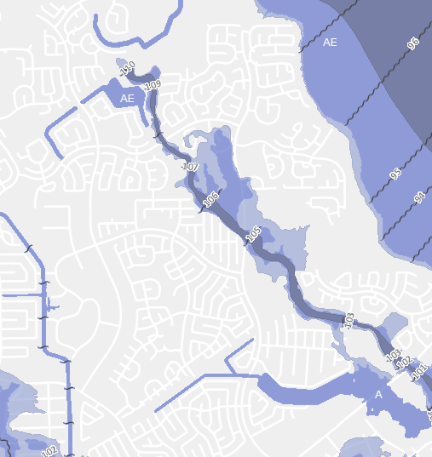
Pre Storm
Family Evacuation Plan
Choose location away from danger area
Plan multiple routes to get there and home
Know where flooding is likely to occur

Slide 4
Imminent Danger
Board windows
Bring in outdoor furniture, garbage cans, anything loose than can be picked up and thrown by winds
Acquire or make ready any generators
If flooding is possible, move valuables to higher space
Fill prescriptions
Fill gas tanks
Alternative fuel and cooking supplies
Alternative lighting

Slide 5
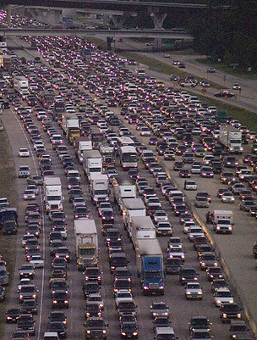
Evacuate
Decide before hand what parameters you will leave under
Leave Early
Tell family, friends, neighbors, church leaders that you are leaving and where you will be
Take pets and plan for their care – only service animals are allowed in public shelters
Secure your home

Slide 6
Shelter in Place
Have a battery or hand crank operated radio
Fill tubs, jugs, and bottles with water
Set refrigerators to coldest setting. Avoid opening doors if power is lost.
Stay away from windows
Close interior doors
Take refuge in small interior room, closet, or hallway on lowest level

Slide 7
After the Storm
Evaluate safety and condition of all family members. Follow family communication plan
Evaluate condition of your home, check for downed electrical wires, broken pipes and structural damage
Avoid using tap water until you are sure it is not contaminated
Be alert for continued rain and flooding
If you evacuated, return home only when instructed
Drive only if necessary
Never run generators indoors or in enclosed spaces

