Slide 1
Houston Gardening
Melanie Masten

Slide 2
First Things First
Keep your expectations low your first year
Start Small – Gardens are scalable
If something doesn’t work, try something else but don’t give up!
“My green thumb came only as a result of the
mistakes I made while learning to see things from
the plant's point of view.” ~H. Fred Dale

Slide 3
Choosing a Location
6-8 hours of full sunlight
Usually on the south or east side of property
Drains ok
Avoid surrounding tree roots if possible

Slide 4
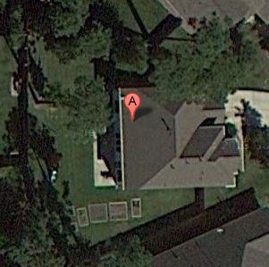

Slide 5
Preparing the Soil
Raised Beds – Houston too clay
Landscape timber, rocks, bricks, cinder blocks etc
Newspaper 4-6 sheets thick or cardboard
3-4 inches compost or garden mix
1 inch layer manure or generous casting of poultry litter fertilizer
2-3 inches mulch or aged tree chippings

Slide 6
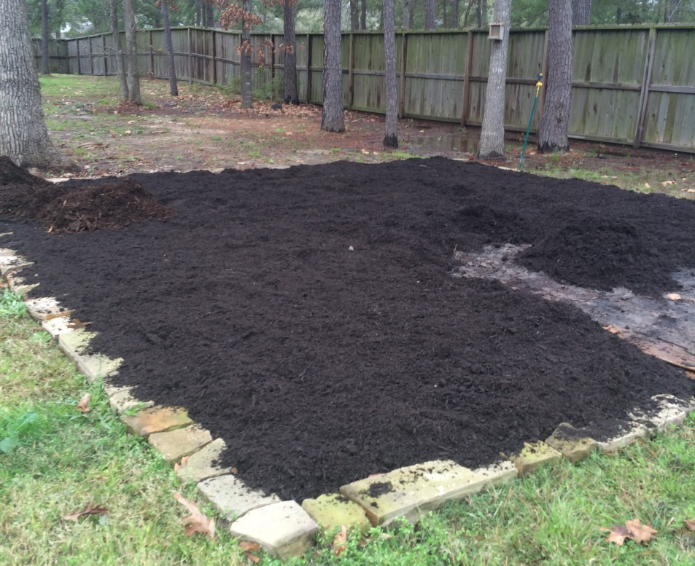
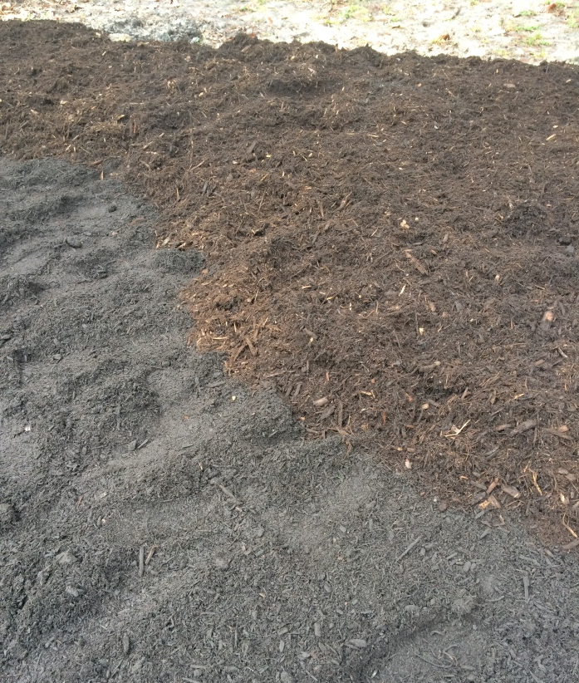
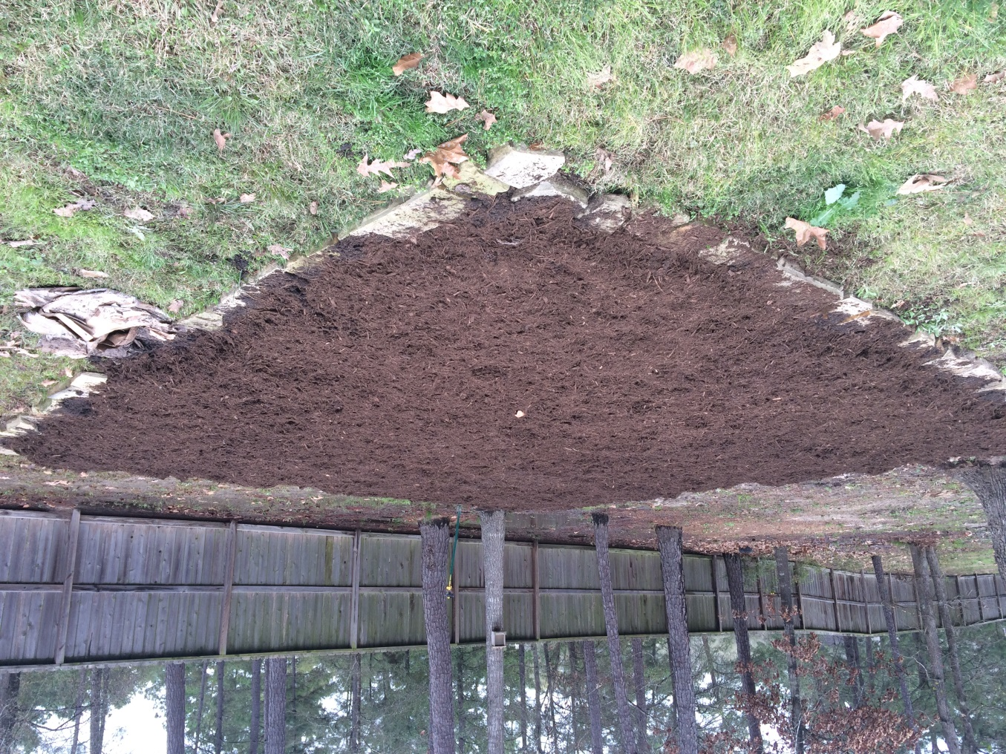

Slide 7
What to Plant
Hardiness Zone 8/9
Vegetables Asparagus Bell Peppers Beets Broccoli Cabbage Carrots Cauliflower Collard Greens Corn Cucumbers Eggplant Green Beans Green Onions Green Peas Jalapeno Peppers Kale Lima Beans Mustard Greens Okra Radish Sugar Snap Peas Sunflower Tomatoes Turnips Yellow Squash Zucchini | Fruits Cantaloupe Figs Strawberries Watermelon Blackberry Persimmon Blueberry Orange Grapefruit Lemon Pineapple | Herbs Basil Cilantro Dill Oregano Parsley Rosemary Sage Spearmint Stevia Tarragon Thyme

Slide 8
How to Plant
Tomatoes, Peppers, and Eggplant from plants, everything else from seed in the ground
Move mulch aside and plant in compost or garden mix. Add cottonseed meal and blood meal with seeds and cover. Water thoroughly
Plant tomatoes below the soil level to generate more roots
Replace mulch around plants and side dress

Slide 9
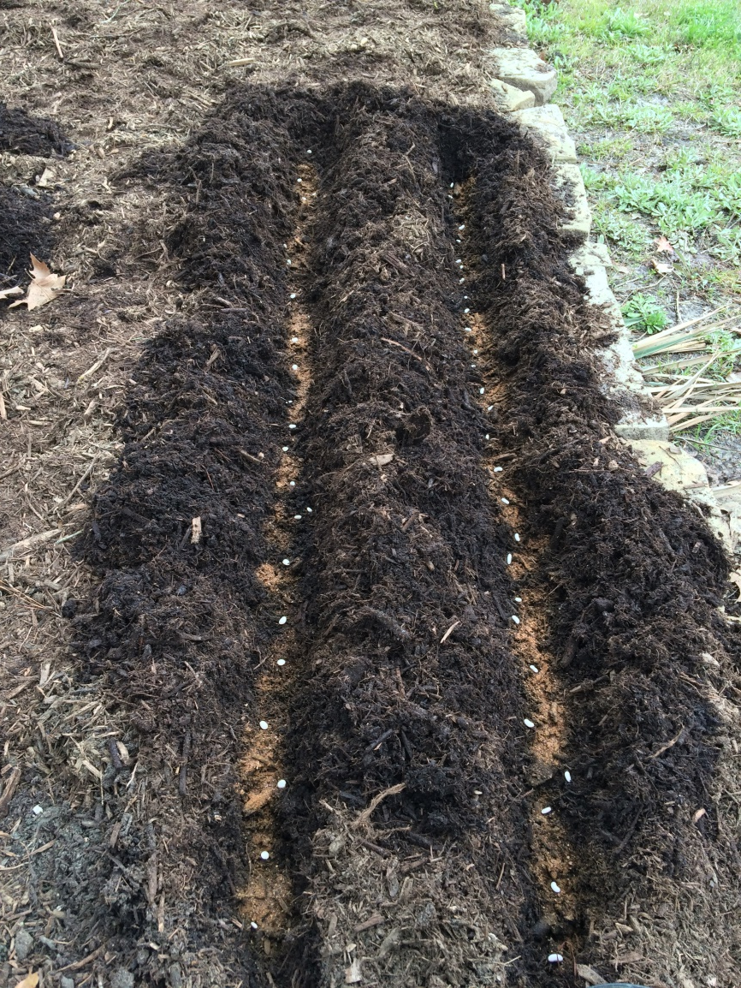
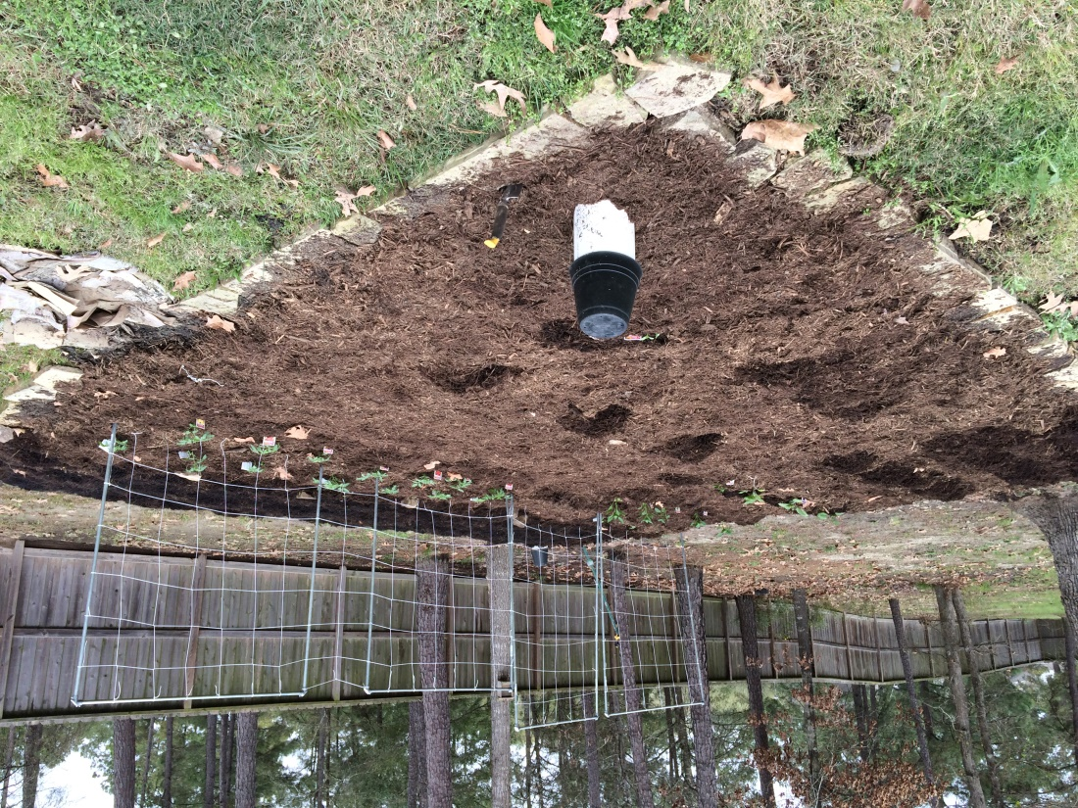

Slide 10
N-P-K
N: Nitrogen – Encourages green plant and leaf development
P: Phosphorus – Encourages flowering and fruiting
K: Potassium – Plant health and vigor. Improving disease resistance.
Magnesium – Improves major and micro nutrient efficiency and usage

Slide 11
Caring For Your Plants
In your first year, fertilize weekly with fish emulsion or miracle grow
Established gardens usually only need feeding with poultry litter fertilizers at the beginning of the season
Trellis vining plants or those needing support
Weed if needed and Trim spent foliage and branches
Or, I like to set it and forget it ‘til harvest

Slide 12
Common Plant Problems
Light green or yellow leaves - stunted growth
Nitrogen deficiency
No flowers or fruit fails to set
Phosphorus deficiency
No bees – no pollination
Weak growth or fruit stays small
Potassium and/or magnesium deficiency
Wilts and dies quickly
Pests

Slide 13
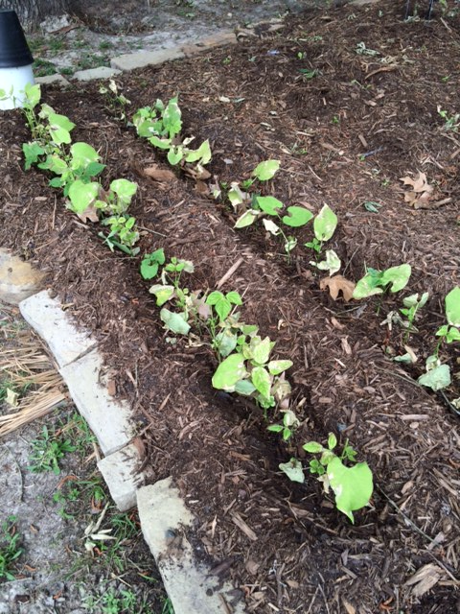

Slide 14
Common Pests
Stink Bugs
Brown Marmorated, Leaf-footed Bug
Squash Vine Borers
Cucumber Beetles
Corn Ear Worms
Tobacco or Tomato Hornworms
Ants & Aphids
Squirrels
Birds

Slide 15
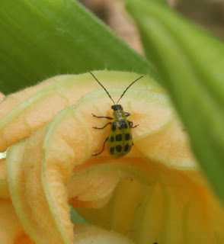
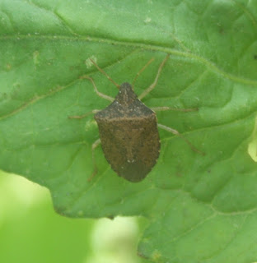
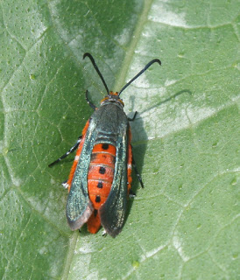
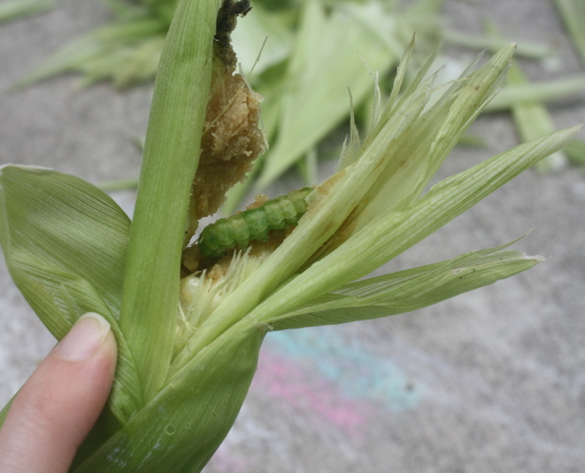
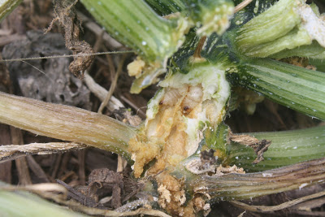

Slide 16
End of Season
Remove or shred spent plants
Weed thoroughly
Add a new layer of manure or poultry litter fertilizer
Add 1-2 inches of mulch or aged tree chippings
Plant again for the next season

Slide 17
Let it Grow!

